Slide 1
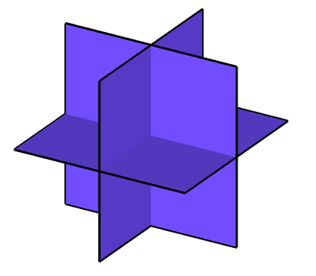







Sparse Euclidean projections onto convex sets
Volkan Cevher
Laboratory for Information and Inference Systems – LIONS / EPFL
http://lions.epfl.ch
joint work with
Stephen Becker
Anastasios Kyrillidis
ISMP’12
lions@epfl
TexPoint fonts used in EMF.
Read the TexPoint manual before you delete this box.: AAAAA

Slide 2



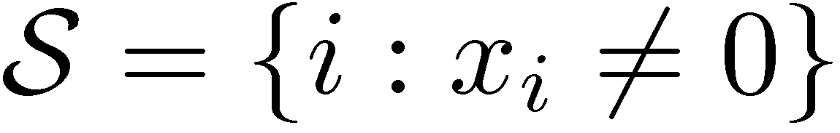
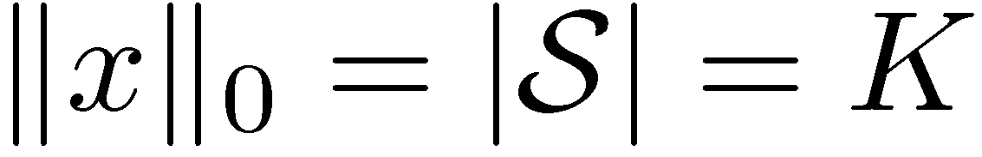

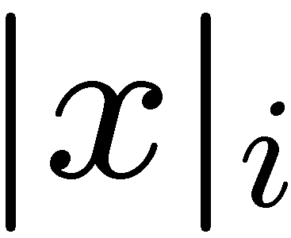


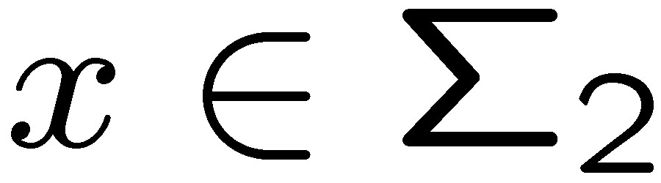


On the “sparse” model
Sparse vector
only K out of N
coordinates nonzero
support:
sorted index

Slide 3

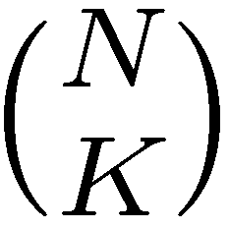
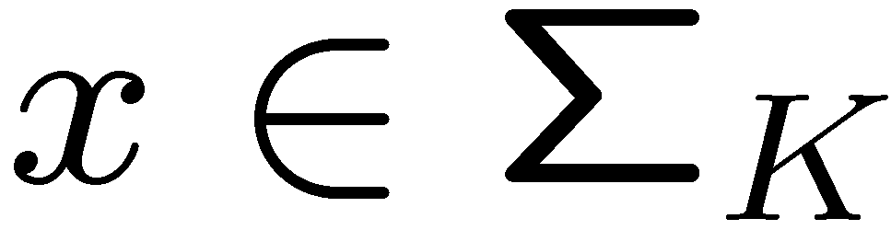
On the “sparse” model
Sparse vector
only K out of N
coordinates nonzero
Many important applications <> model-of-choice
  regression (linear / nonlinear), classification, density estimation, principal component analysis, compressive sensing, spectrum estimation, denoising, deblurring, data mining, sketching, demixing / deconvolution, geophysics, medical imaging, compression, source localization, speech, function learning…
Great theoretical backup explaining empirical success
  provably effective in circumventing the ill-posed nature of inverse problems
  provably essential in containing the generalization errors in learning
  provably necessary in keeping transaction costs low in portfolio design
  …

Slide 4

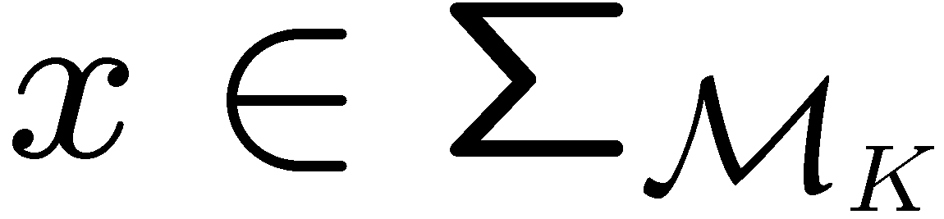
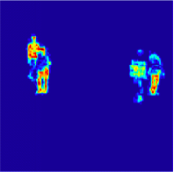
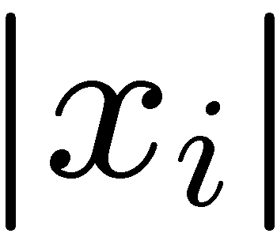
On the “structured sparse” model
Structured sparse vector
only certain K out of N
coordinates nonzero
Many important applications <> model-of-choice
  regression (linear / nonlinear), classification, density estimation, principal component analysis, compressive sensing, spectrum estimation, denoising, deblurring, data mining, sketching, demixing / deconvolution, geophysics, medical imaging, compression, source localization, speech, function learning…
sorted index

Slide 5
On the “structured sparse” model
Structured sparse vector
only certain K out of N
coordinates nonzero
Many important applications <> model-of-choice
  regression (linear / nonlinear), classification, density estimation, principal component analysis, compressive sensing, spectrum estimation, denoising, deblurring, data mining, sketching, demixing / deconvolution, geophysics, medical imaging, compression, source localization, speech, function learning…
sorted index

Slide 6
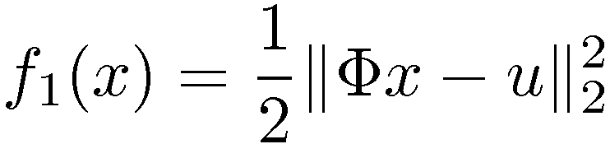
Optimization with the sparse models
Applications require
data fidelity term; mostly convex, smooth.
typically:
sparsity-based regularizer/indicator;
maybe convex and non-smooth;
or non-convex...
Difficulties: non-smoothness, non-convexity, and large dimension

Slide 7
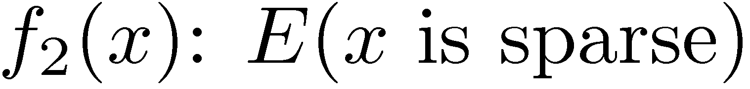
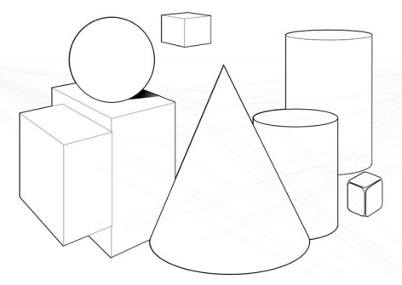
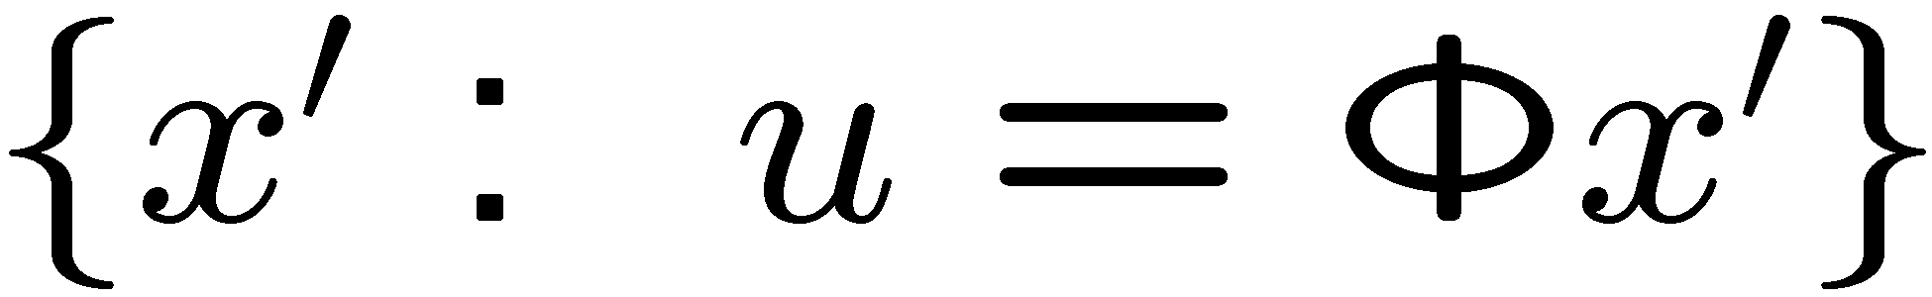

Optimization with the sparse models
Goal:
 | Non-convex | Convex
Encoding E | combinatorial | convex relaxation
Example

Slide 8
Optimization with the sparse models
Goal:
Sparsity inherently discrete
non-convex encoder +simpler description of the model and
its structured variations
+projections with combinatorial algorithms with optimal time and space bounds
- difficult to analyze / no-scale
  convex encoder - harder description of the model & struct.
  +efficient/general convex projections
  +easier to analyze / known scale
 | Non-convex | Convex
Encoding E | combinatorial | convex relaxation
Example

Slide 9
Optimization with the sparse models
Goal:
Modus operandi: convex > non-convex*
key lessons: ell1 encodes sparsity extremely effectively
+
convexity (a rare condition) is powerful
 | Non-convex | Convex
Encoding E | combinatorial | convex relaxation
Example
*for simple sparsity models

Slide 10
Optimization with the sparse models
Goal:
Modus operandi: convex > non-convex*
* for simple sparsity models
CLASH/NP: the power of the two frameworks for quadratic convex problems
 | Non-convex | Convex
Encoding E | combinatorial | convex relaxation
Example
sparsity & structure + geometry
[Kyrillidis and C, 2011]

Slide 11
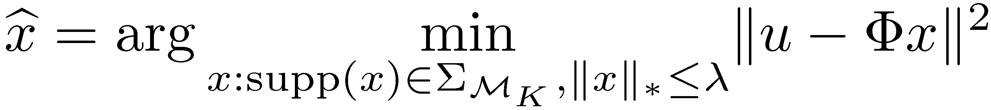
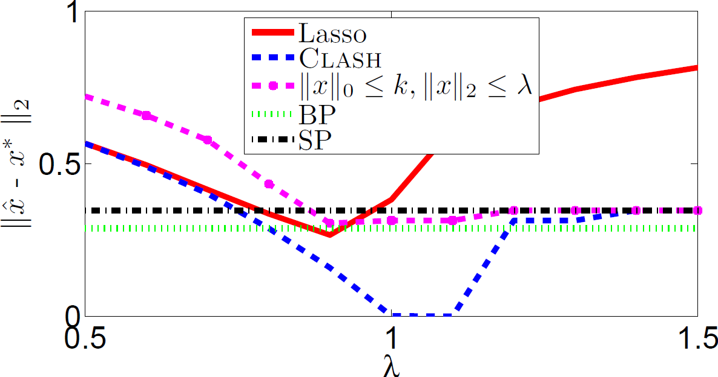
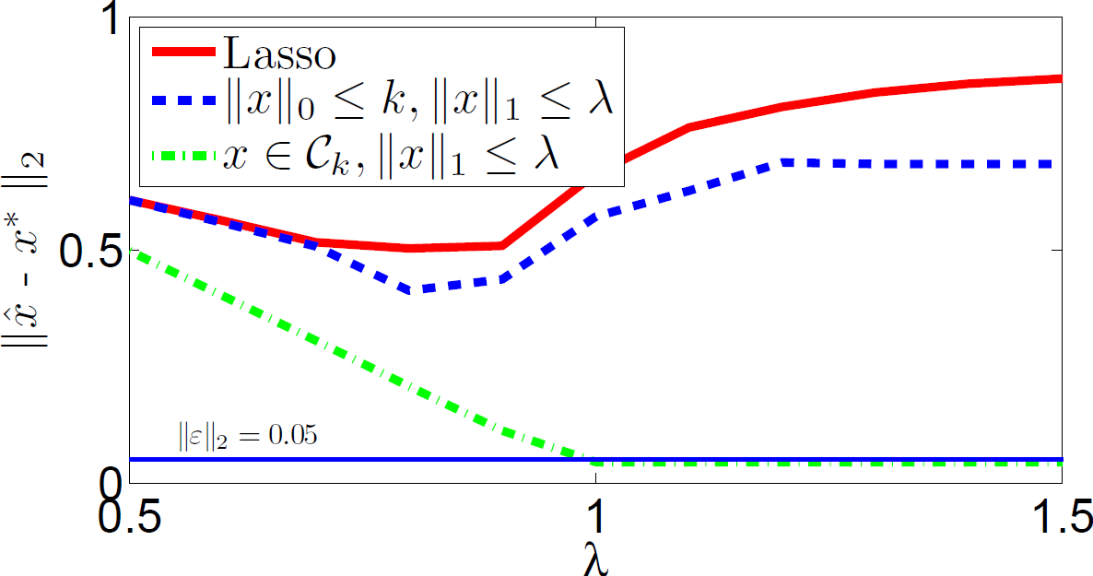

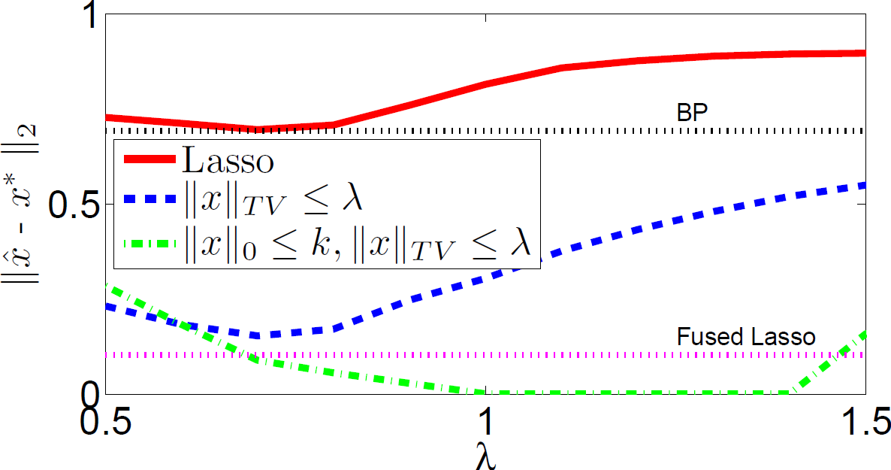
A preview
CLASH
Structured Sparsity
Norm Constraints
[Kyrillidis, Puy, and C, 2012]

Slide 12

A Real Clash of Sparsity Models

Slide 13

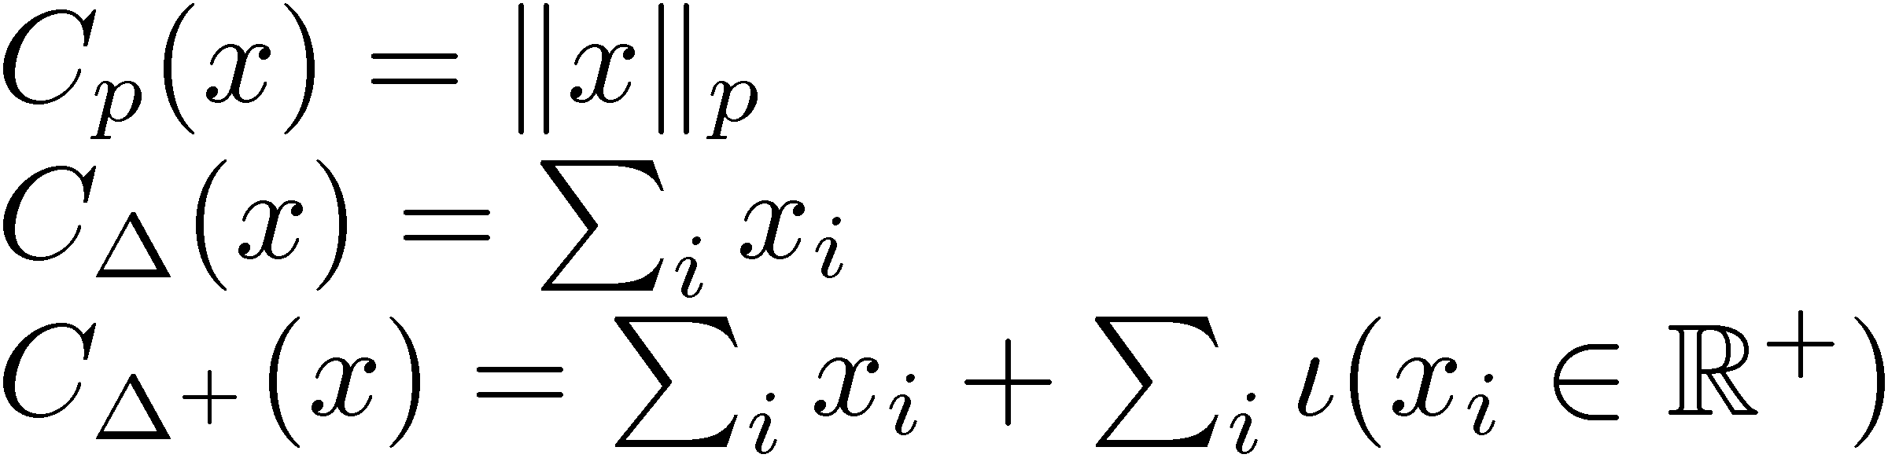
If ell1 is already taken, what do we do?
f₁: convex
C encodes constraints
Density estimation
  Examples: sparse mixture/kernel models with small sample size, nonparametric density estimation, aggregation of density estimators
Markowitz Portfolio optimization
  Examples: minimum variance portfolio with no-short positions
  minimum variance portfolio with short positions
Many other applications boosting classifiers, NNMF, ED, etc…
[Bunea, Tsybakov, and Wegkamp, 2010; Willet and Nowak, 2007]
[Brodie et al., 2008]
sparsity is still required!

Slide 14
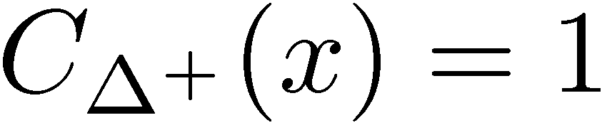
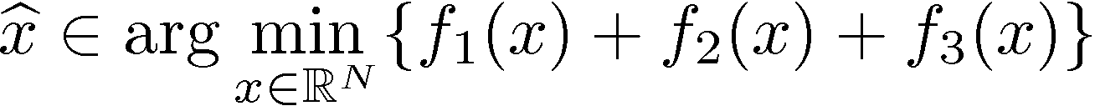
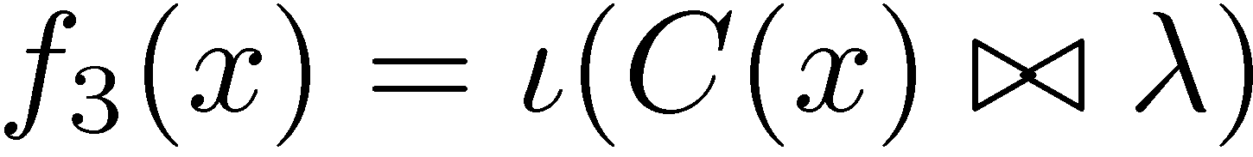
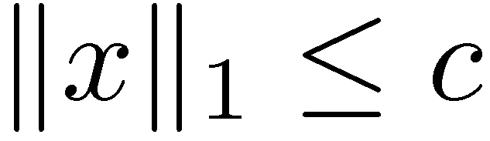
If ell1 is already taken, what do we do?
C encodes constraints
sparsity-based f₂ and the constraint f₃ can conflict with each other!
Density estimation
Markowitz Portfolio optimization
Many other applications boosting classifiers, NNMF, ED, etc…
Sparsity is still required!
[Bunea, Tsybakov, and Wegkamp, 2010; Willet and Nowak, 2007]
[Brodie et al., 2008]

Slide 15
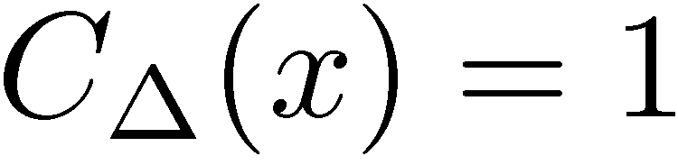
If ell1 is already taken, what do we do?
C encodes constraints
sparsity-based f₂ and the constraint f₃ can conflict with each other!
Density estimation
Markowitz Portfolio optimization
Many other applications boosting classifiers, NNMF, ED, etc…
Sparsity is still required!
[Bunea, Tsybakov, and Wegkamp, 2010; Willet and Nowak, 2007]
[Brodie et al., 2008]

Slide 16

If ell1 is already taken, what do we do?
C encodes constraints
sparsity-based f₂ can bias the data-fidelity
Density estimation
Markowitz Portfolio optimization
Many other applications boosting classifiers, NNMF, ED, etc…
Sparsity is still required!
[Bunea, Tsybakov, and Wegkamp, 2010; Willet and Nowak, 2007]
[Brodie et al., 2008]

Slide 17
If ell1 is already taken, what do we do?
C encodes constraints
sparsity-based f₂ can bias the data-fidelity
1. de-biased solutions are not necessarily sparse stationary points of f₁ + the constraint C
2. it may not sparsify the solution enough!
Density estimation
Markowitz Portfolio optimization
Many other applications boosting classifiers, NNMF, ED, etc…
Sparsity is still required!
[Bunea, Tsybakov, and Wegkamp, 2010; Willet and Nowak, 2007]
[Brodie et al., 2008]

Slide 18
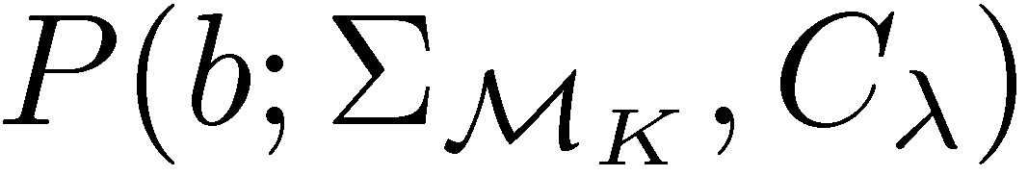
Problems where ell1 is already taken
and beyond…
Objective:

Slide 19
Problems where ell1 is already taken
and beyond…
Objective:
  in general, NP-Hard!

Slide 20
Problems where ell1 is already taken
and beyond…
Objective:
Motivation: convergence of the forward-backward
algorithm for non-convex sets
  obtain stationary points of convex optimization objective*
*with Lipschitz gradient
[Attouch et al. 2010]

Slide 21
Problems where ell1 is already taken
and beyond…
Objective:
Motivation: convergence of the forward-backward
algorithm for non-convex sets
  obtain stationary points of convex optimization objective*
Key actors for hire:
  convex projector
  sparse projector
*with Lipschitz gradient
[Attouch et al. 2010]

Slide 22
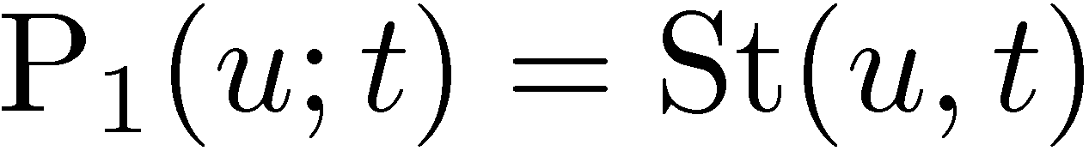

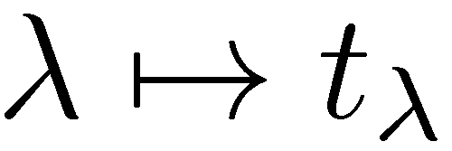


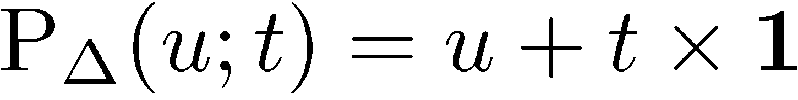
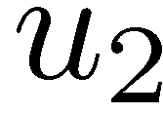
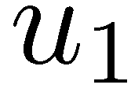
Convex projectors*
Examples
  ell1 ball
  simplex
  positive-simplex
  combination of the two
soft
thresholding
  coordinate-bias
*I will abuse the term and use it also for prox operators.

Slide 23
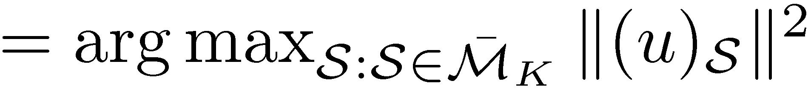
Sparse projectors
Examples
  support of the solution <> modular approximation problem
[Kyrillidis and C, 2011]

Slide 24
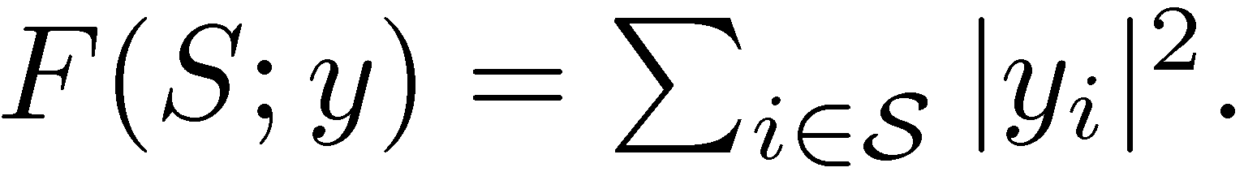
Sparse projectors
Examples
  support of the solution <> modular approximation problem
  where
[Kyrillidis and C, 2011]

Slide 25
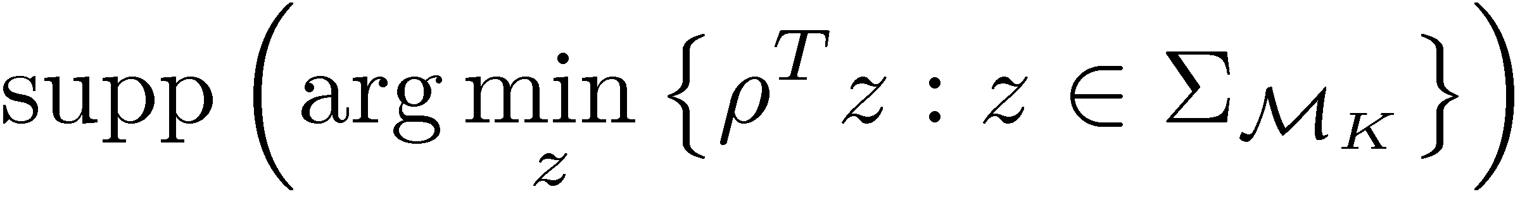
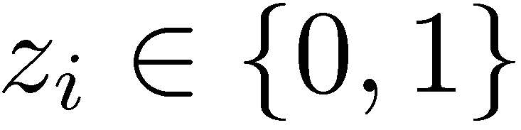
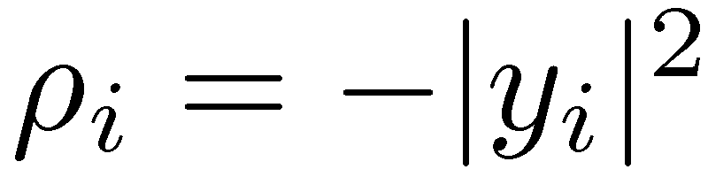
Sparse projectors
Examples
  support of the solution <> modular approximation problem
  where
  support of the solution <> integer linear program
: support indicator variables
[Kyrillidis and C, 2011]

Slide 26
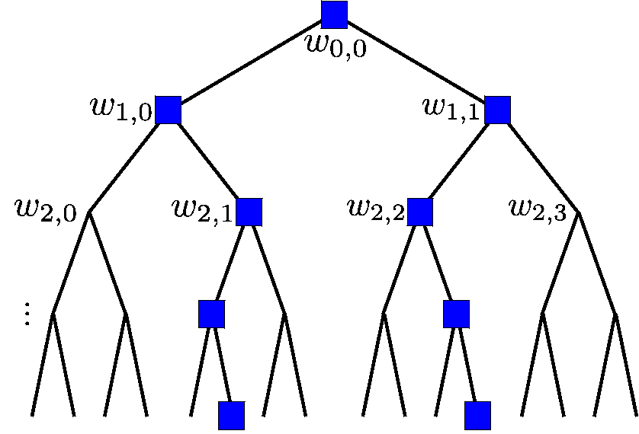
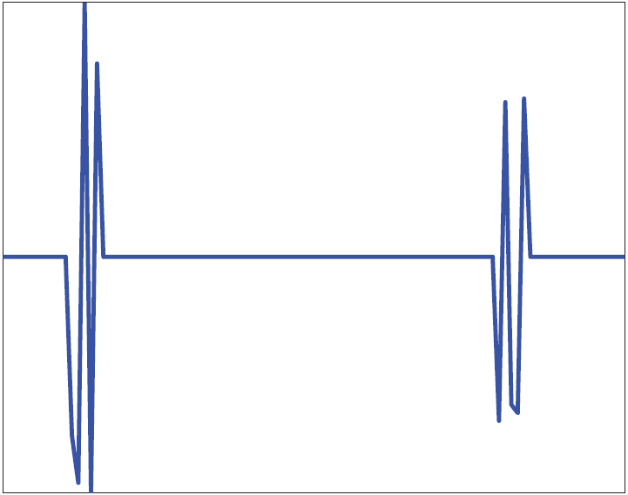
Sparse projectors
Examples
  support of the solution <> modular approximation problem
  support of the solution <> integer linear program
matroid structured sparse models
1. uniform matroid <> simple sparsity
intersection with the following matroids (result is still a matroid!*)
2. partition matroid <> distributed sparsity
3. graphic matroid <> spanning tree sparsity
4. matching matroid <> graph matching sparsity
projector: Greedy basis algorithm
clustered sparsity models
clustered-tree
clustered-line model
projector: dynamic programming
A and b <> integral
first row of A <> all 1’s
first entry of b <> K
when A is totally unimodular,
projector: linear program
*: in general, the intersection of two matroids is not a matroid.
[Kyrillidis and C, 2011]

Slide 27
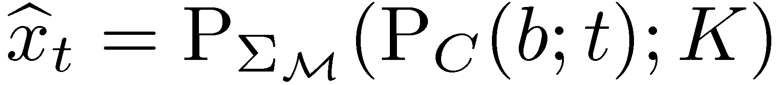
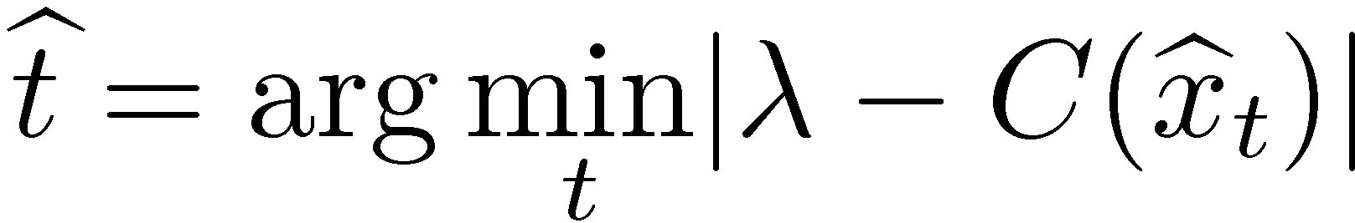
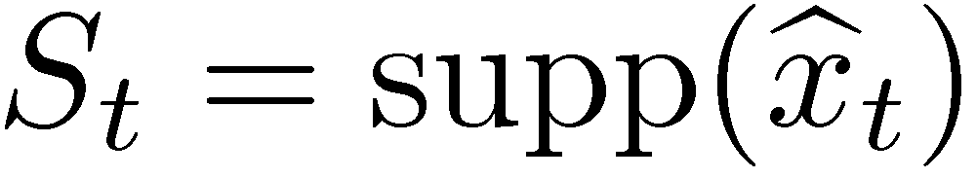
Sparse Euclidean projections on convex sets
Algorithm:
1.
2.

Slide 28
Sparse Euclidean projections on convex sets
Algorithm:
1.
2.
piece of cake.

Slide 29
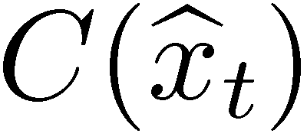


Sparse Euclidean projections on convex sets
Algorithm:
1.
2.
seems tough.

Slide 30
Sparse Euclidean projections on convex sets
Algorithm:
1.
2.
ditto.

Slide 31
Sparse Euclidean projections on convex sets
Algorithm:
1.
2.
is this what we wanted to solve???

Slide 32

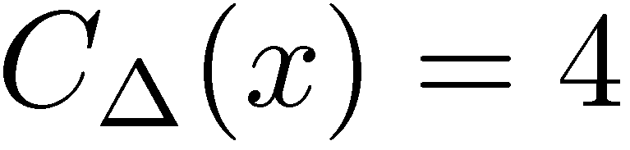
Sparse Euclidean projections on convex sets
Algorithm:
1.
2.
Example:
5
2
0
0
-1

Slide 33
Sparse Euclidean projections on convex sets
Algorithm:
1.
2.
Example:
5
5
2
0
0
0
0
0
Error = 4
-1
-1
by inspection!
this is hard by inspection in high-dimensions!

Slide 34
Sparse Euclidean projections on convex sets
Algorithm:
1.
2.
Example:
5
5
2
0
0
0
0
0
Error = 4
-1
-1
by inspection!
Let’s stage the actors!
this is hard by inspection in high-dimensions!

Slide 35
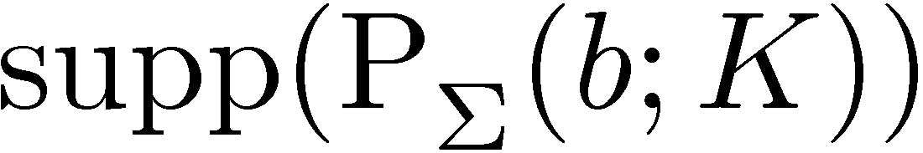
Sparse Euclidean projections on convex sets
Algorithm:
1.
2.
Naïve approaches:
5
3.5
2
0.5
0
0
0
0
Error = 5.5
-1
0
so, non-convex followed by convex does not work here.

Slide 36
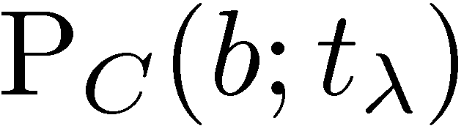
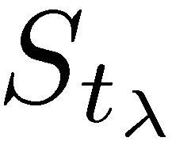
Sparse Euclidean projections on convex sets
Algorithm:
1.
2.
Naïve approaches:
5
3.5
2
0.5
0
0
0
0
Error = 5.5
-1
0
4.6
1.6
-0.4
-0.4
-1.4
well, neither does convex followed by non-convex!

Slide 37
Sparse Euclidean projections on convex sets
Algorithm:
1.
2.
Naïve approaches:
5
5
2
0
0
0
0
0
Error = 4
-1
-1
our algorithm
surprisingly, our algorithm obtains the correct solution!

Slide 38
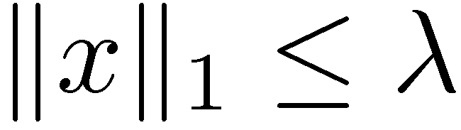
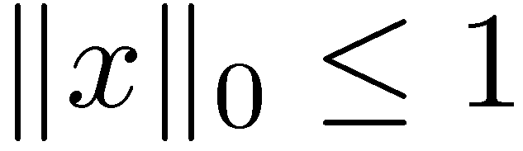
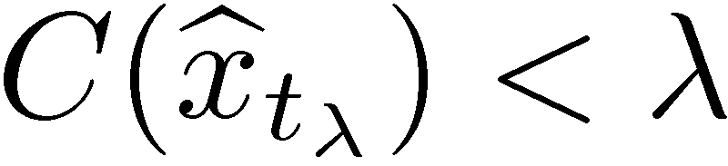
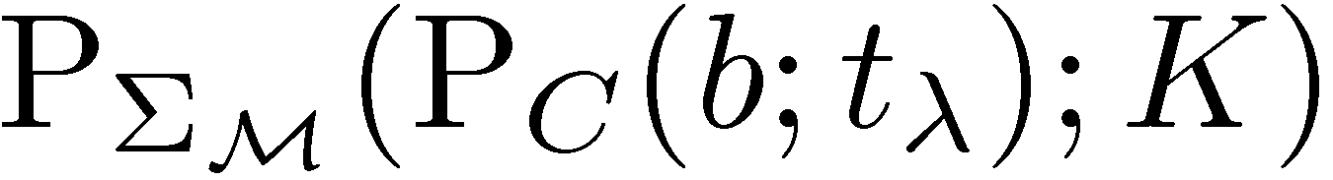
Sparse Euclidean projections on convex sets
Algorithm:
1.
2.
So, what do actually we do?
&

Slide 39
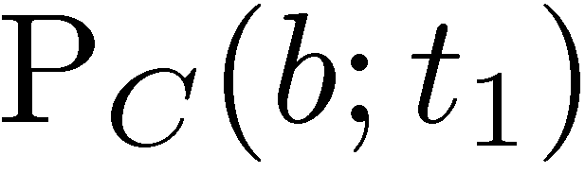


Sparse Euclidean projections on convex sets
Algorithm:
1.
2.
So, what do actually we do?
&

Slide 40



Sparse Euclidean projections on convex sets
Algorithm:
1.
2.
So, what do actually we do?
&

Slide 41



Sparse Euclidean projections on convex sets
Algorithm:
1.
2.
So, what do actually we do?
&

Slide 42
More on the algorithm
Algorithm:
1.
2.
Highlights:
  optimality / online optimality / online approximation guarantees
  efficiency of the scheme

Slide 43



More on the algorithm
Algorithm:
1.
2.
Highlights:
  optimality / online optimality / online approximation guarantees
  efficiency of the scheme
Intuition: online optimality
straightforward to establish for

Slide 44
More on the algorithm
Algorithm:
1.
2.
Highlights:
  optimality / online optimality / online approximation guarantees
  efficiency of the scheme
Intuition: efficiency
bisection
monotonicity of
boundedness of

Slide 45



More on the algorithm
Algorithm:
1.
2.
Highlights:
  optimality / online optimality / online approximation guarantees
  efficiency of the scheme
Intuition: online approximation guarantee
bisection

Slide 46
More on the algorithm
Algorithm:
1.
2.
Highlights:
  optimality / online optimality / online approximation guarantees
  efficiency of the scheme
Intuition: optimality
+monotonicity
+continuity
+equivalence
bisection

Slide 47


More on the algorithm
Algorithm:
1.
2.
Highlights:
  optimality / online optimality / online approximation guarantees
  efficiency of the scheme
Intuition: optimality
For simple sparsity
for p=1,2, and inf

Slide 48
More on the algorithm
Algorithm:
1.
2.
Highlights:
  optimality / online optimality / online approximation guarantees
  efficiency of the scheme
Intuition: optimality
For structured sparsity
for p=2 and inf

Slide 49

More on the algorithm
Algorithm:
1.
2.
Highlights:
  optimality / online optimality / online approximation guarantees
  efficiency of the scheme
Intuition: sub-optimality
For structured sparsity

Slide 50
More on the algorithm
Algorithm:
1.
2.
Highlights:
  optimality / online optimality / online approximation guarantees
  efficiency of the scheme
Alternative: proximal alternating minimization algorithm
  a general hammer for such problems
  with sublinear convergence rate
[Attouch et al. 2010]

Slide 51


Experiments
Kernel density learning:

Slide 52

Experiments
Markowitz portfolio selection:

Slide 53

Experiments
Simplex:

Slide 54
Conclusions
Structured sparse projections on convex sets
  highlights online optimality / approximation guarantees
  efficient scheme
  1-shot projections for certain combinations*
  needs more work case-by-case analysis
  more than one-parameter projectors
Upshot sparse stationary points of constrained convex objectives
fixed sparse solutions
(t,C(x_{t}))-curve reveals the difficulty of the projection
  conjecture monotonicity is preserved if C is convex
Analysis generalizes to argmax
* 1/k problem!

Slide 55

Postdoc positions @ LIONS / EPFL
contact: volkan.cevher@epfl.ch

