Slide 1
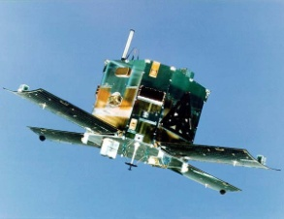
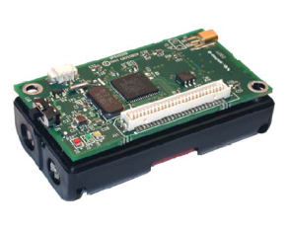
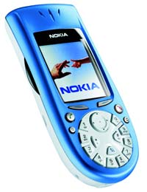
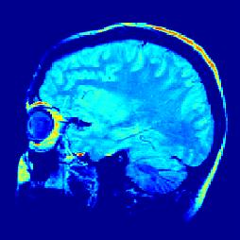
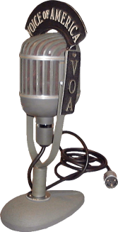
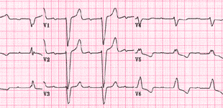
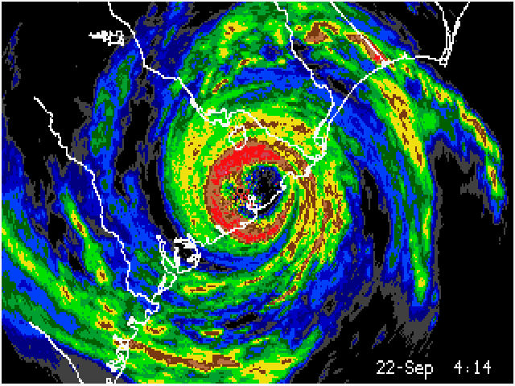
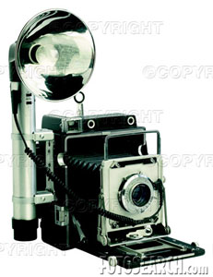
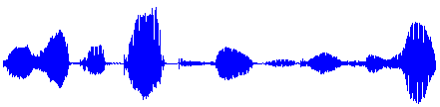
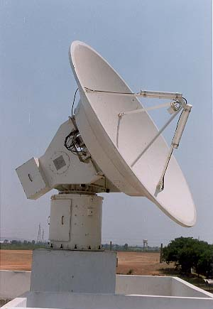


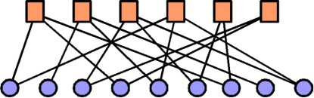
Model-based
Compressive
Sensing
Volkan Cevher
volkan@rice.edu

Slide 2
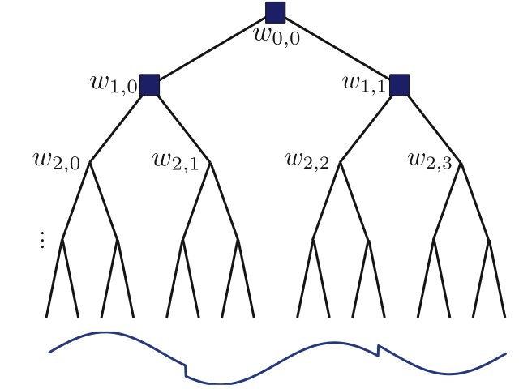

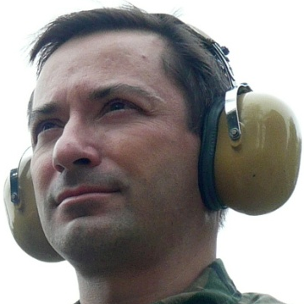
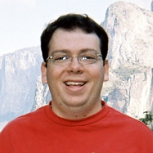
Chinmay Hegde
Richard Baraniuk
Marco Duarte

Slide 3
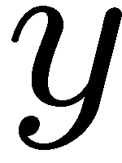


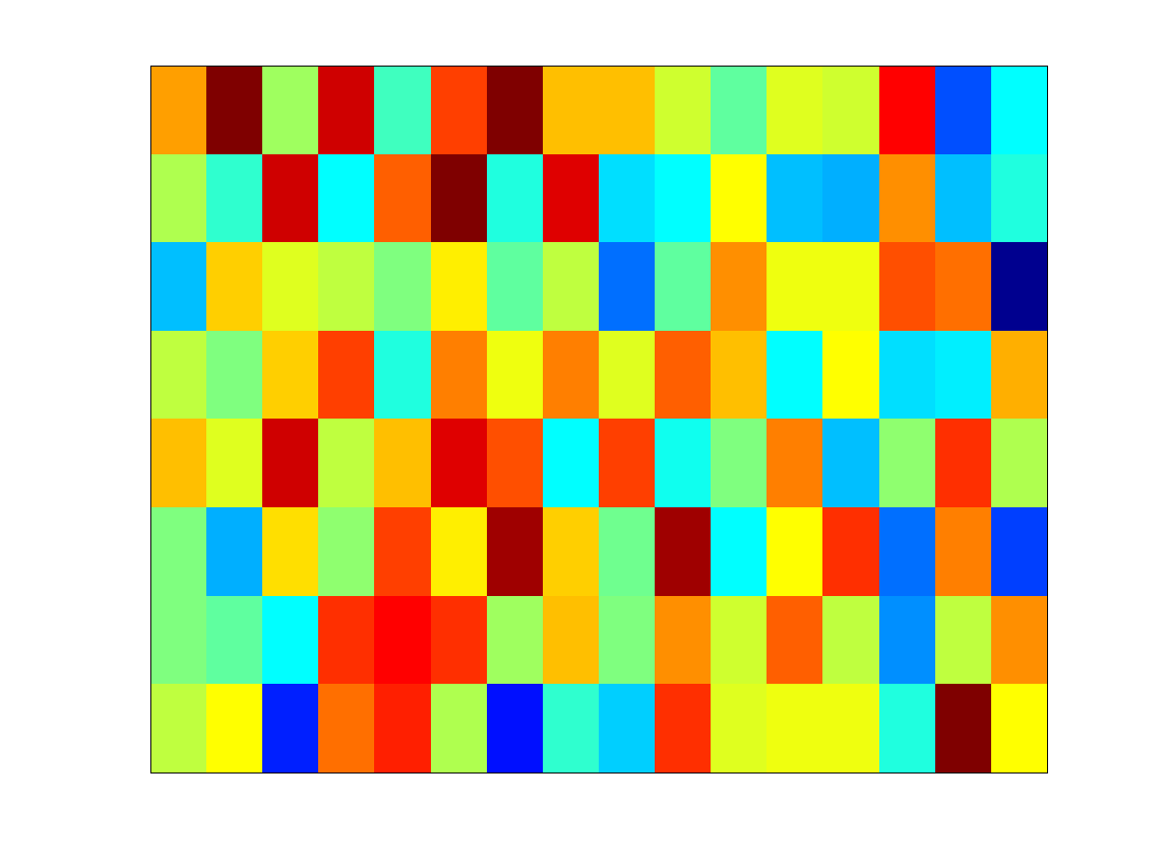




Dimensionality Reduction
Compressive sensing non-adaptive measurements
Sparse Bayesian learning dictionary of features
Information theory coding frame
Computer science sketching matrix / expander

Slide 4
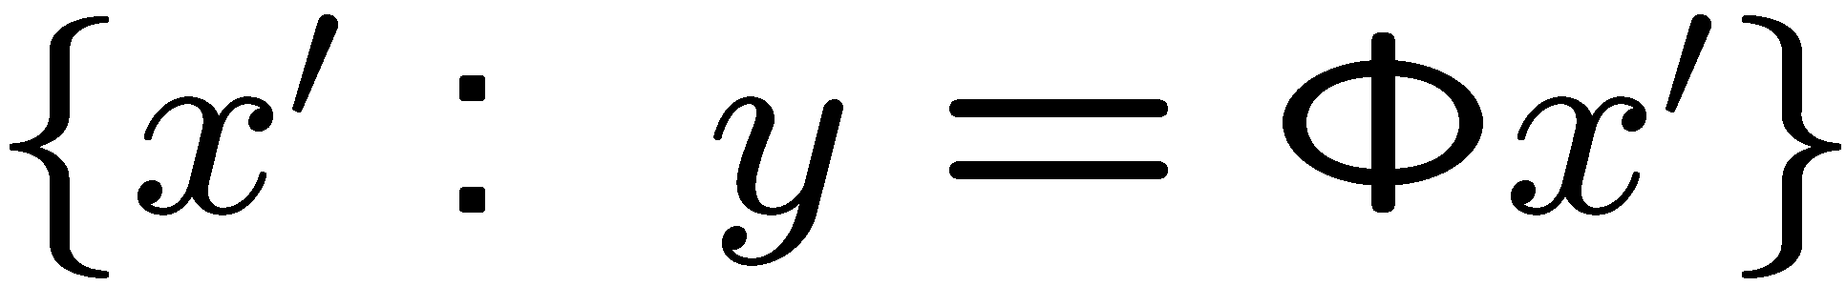
Underdetermined Linear Regression
Challenge: nullspace of

Slide 5
Key Insights from the Compressive Sensing
Sparse or compressible
not sufficient alone
Projection
information preserving
(restricted isometry property - RIP)
Decoding algorithms
tractable

Slide 6

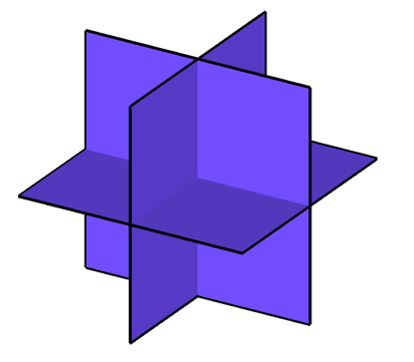

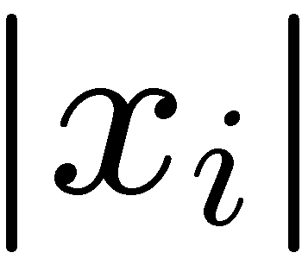
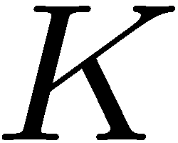

Deterministic Priors
Sparse signal: only K out of N
coordinates nonzero
  model: union of K-dimensional subspaces
  aligned w/ coordinate axes
sorted index

Slide 7
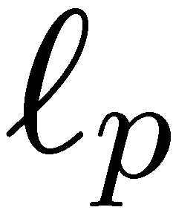
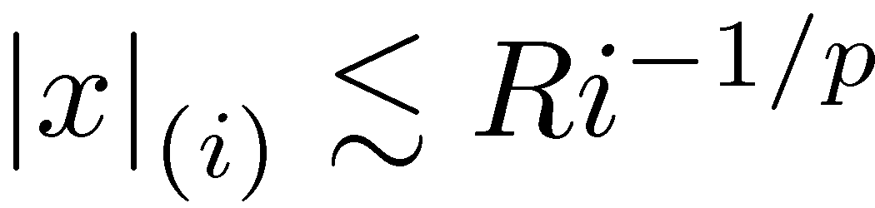
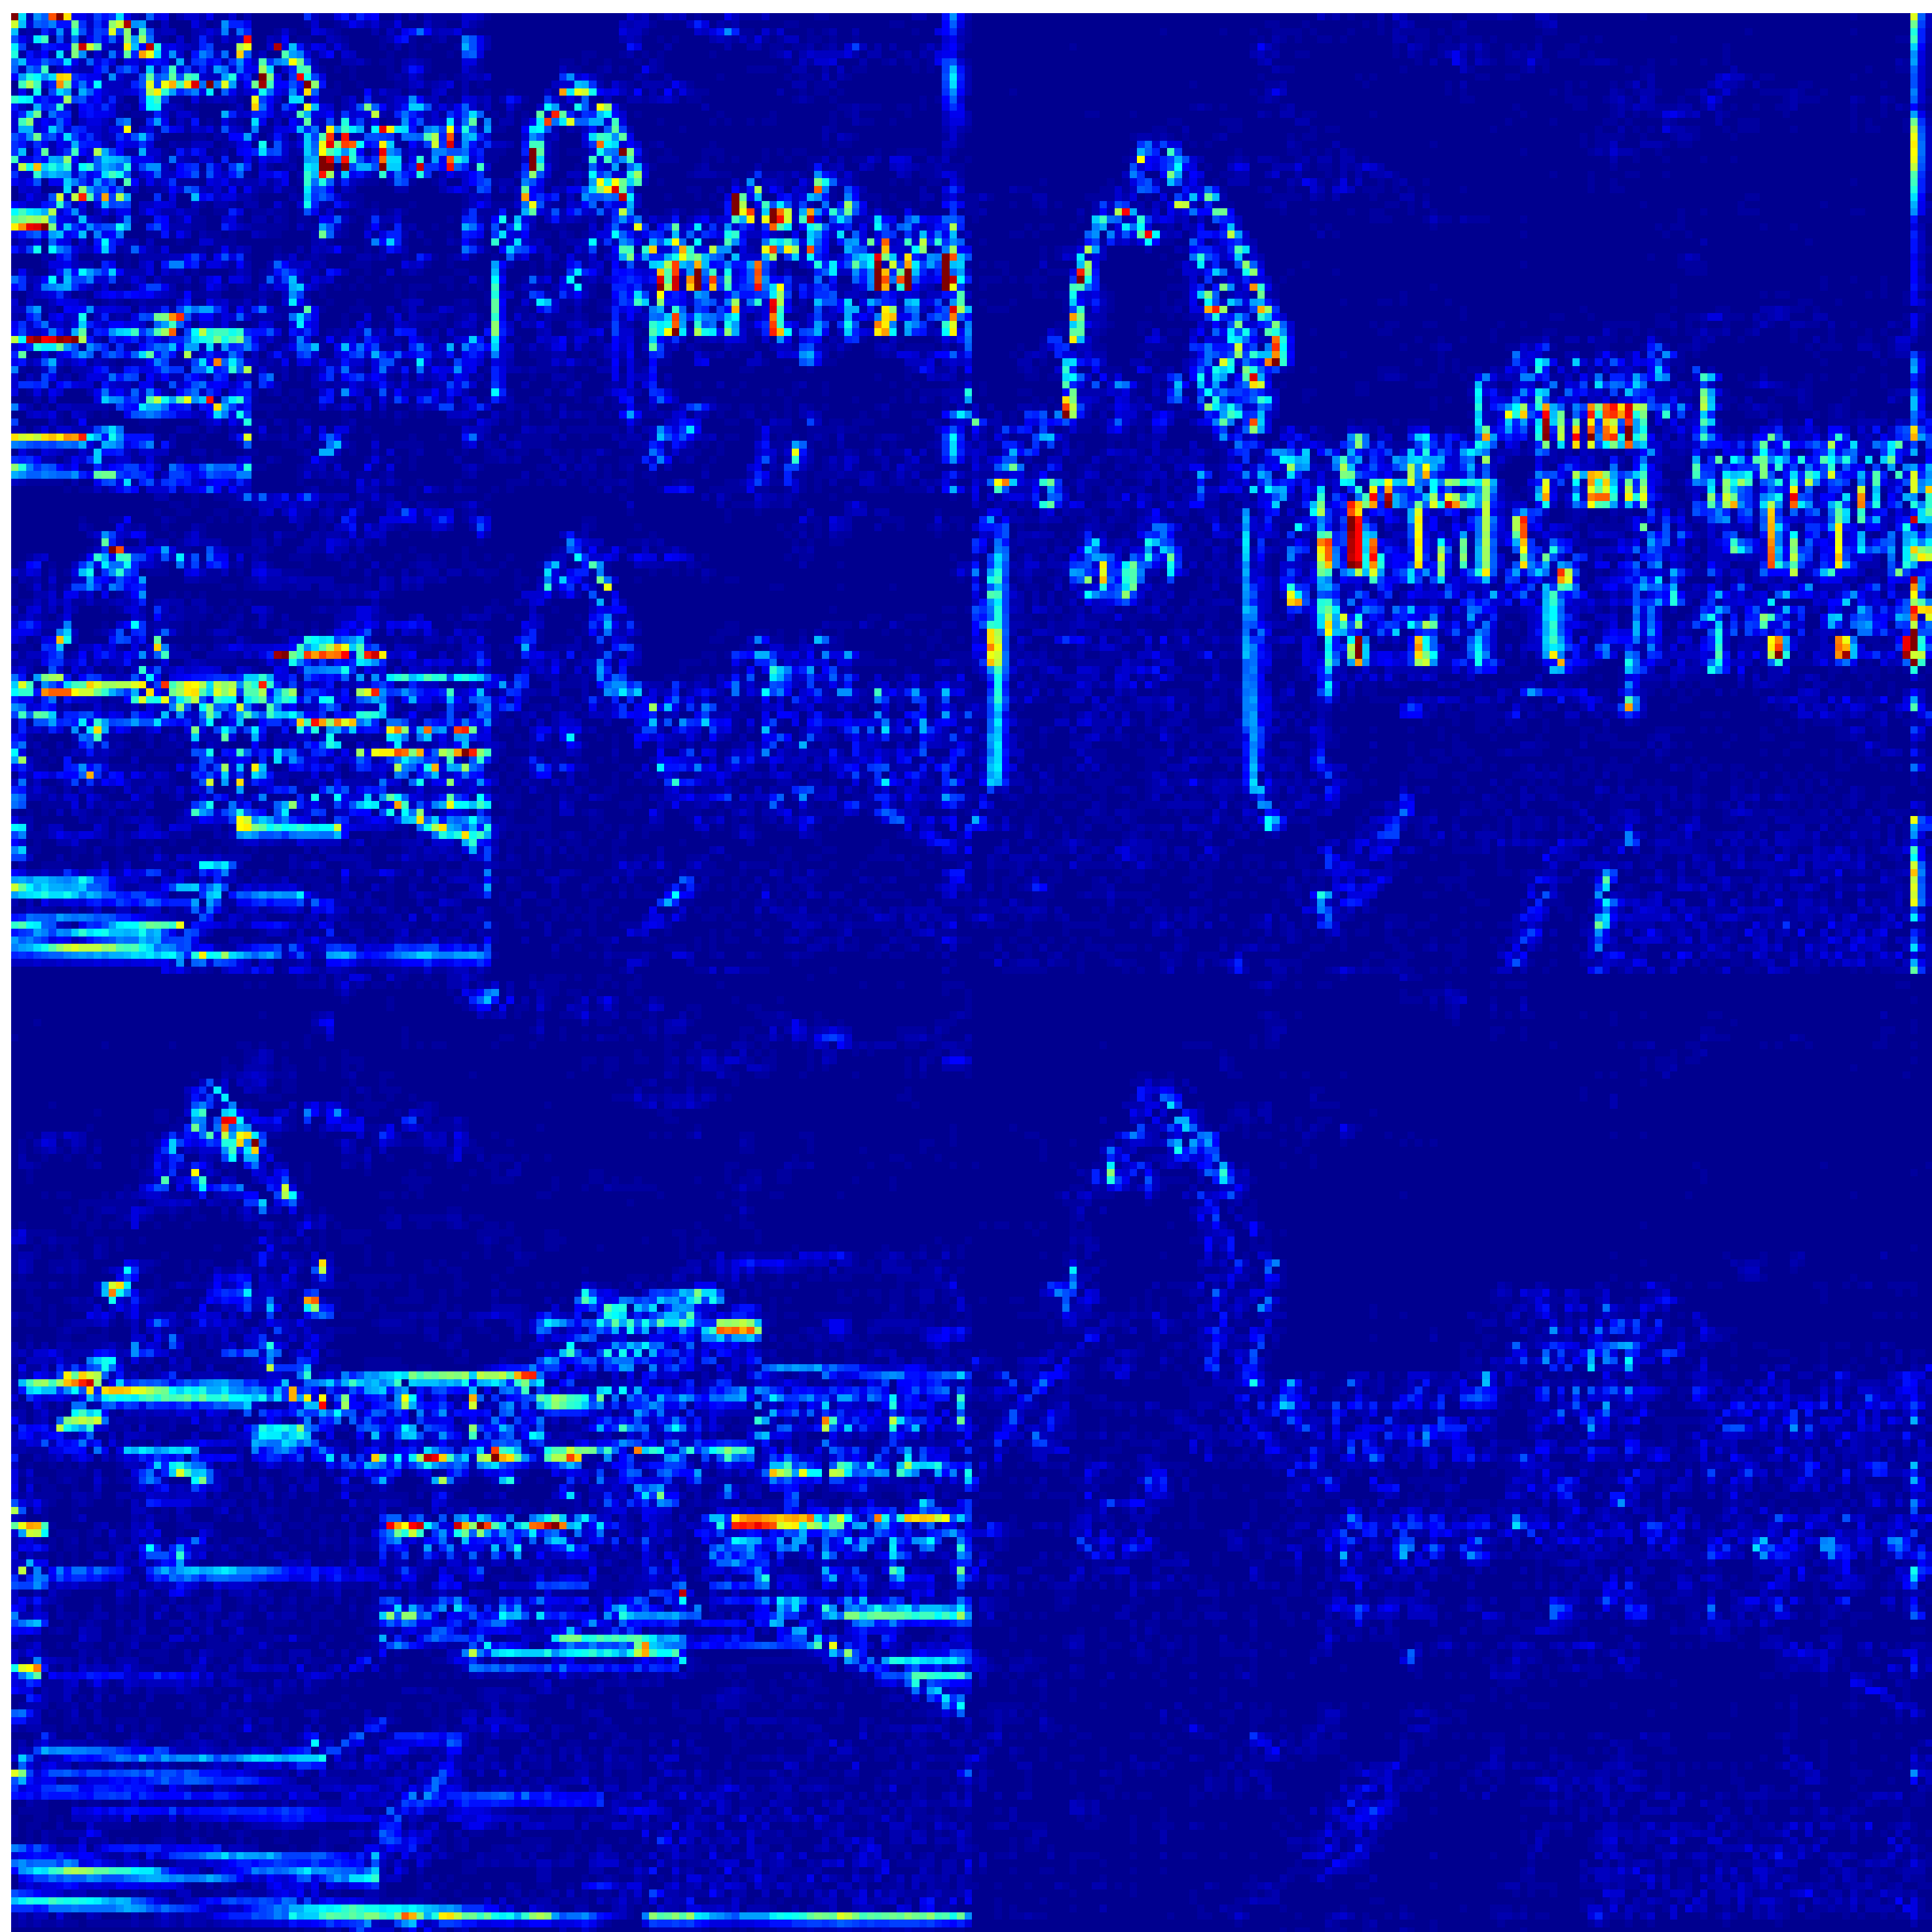
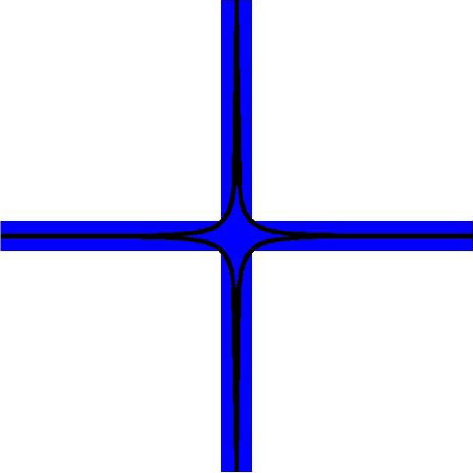
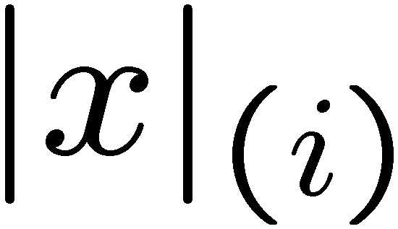
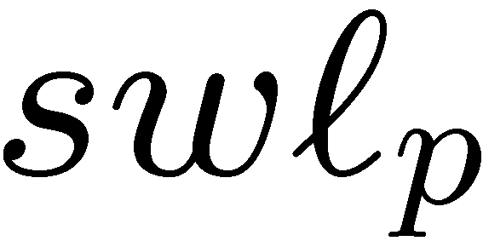
Deterministic Priors
Sparse signal: only K out of N
coordinates nonzero
  model: union of K-dimensional subspaces
Compressible signal: sorted coordinates decay rapidly to zero
  Model: weak shell
power-law
decay
sorted index

Slide 8
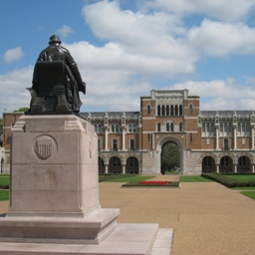
Deterministic Priors
Sparse signal: only K out of N
coordinates nonzero
  model: union of K-dimensional subspaces
Compressible signal: sorted coordinates decay rapidly to zero
well-approximated by a K-sparse signal
(simply by thresholding)
sorted index

Slide 9
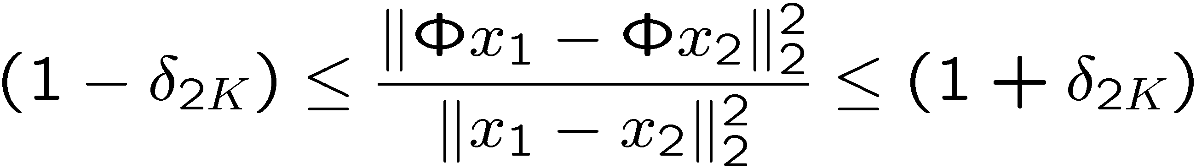




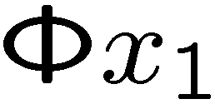
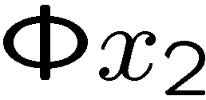
Restricted Isometry Property (RIP)
Preserve the structure of sparse/compressible signals
RIP of order 2K implies: for all K-sparse x₁ and x₂
K-planes

Slide 10
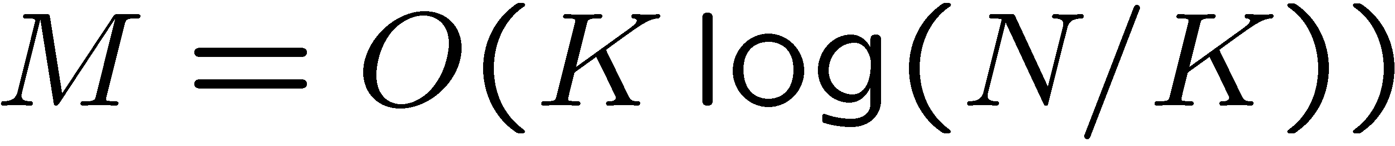
Restricted Isometry Property (RIP)
Preserve the structure of sparse/compressible signals
Random subGaussian (iid Gaussian, Bernoulli) matrix has the RIP with high probability if
K-planes

Slide 11
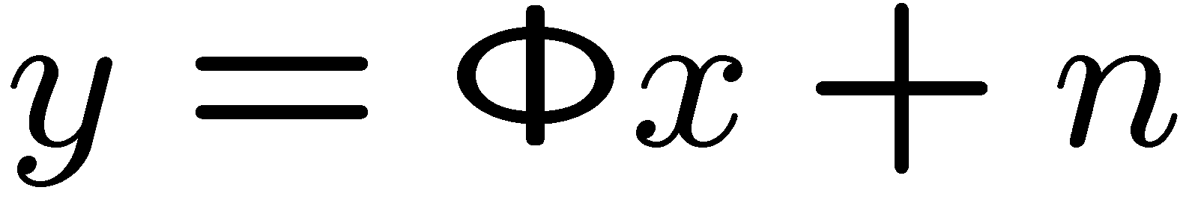




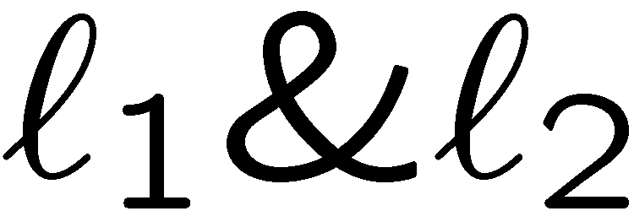
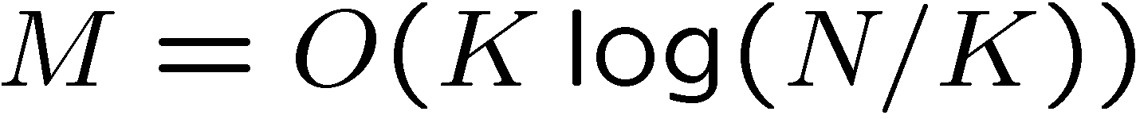
Recovery Algorithms
Goal: given
recover
and convex optimization formulations
  basis pursuit, Lasso, scalarization …
  iterative re-weighted algorithms
Greedy algorithms: CoSaMP, IHT, SP

Slide 12
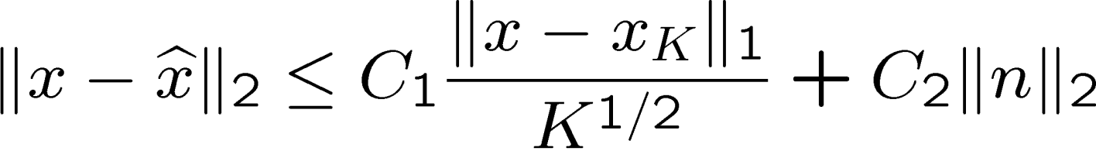
Performance of Recovery
Tractability polynomial time
Sparse signals
  noise-free measurements: exact recovery
  noisy measurements: stable recovery
Compressible signals
  recovery as good as K-sparse approximation
CS recovery
error
signal K-term
approx error
noise

Slide 13

From Sparsity to
Structured parsity

Slide 14
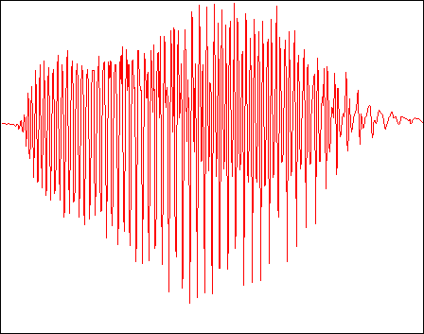
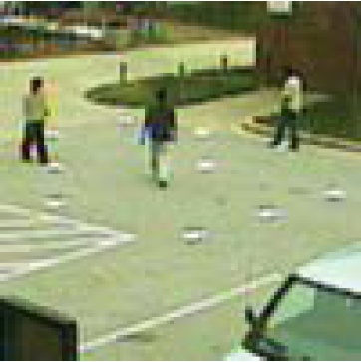

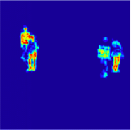
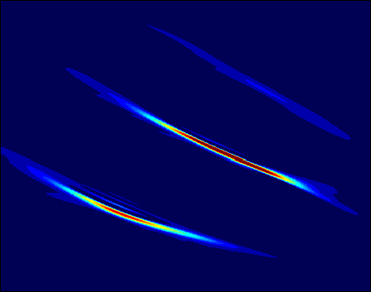
Sparse Models
pixels:
background subtracted images
wavelets:
natural images
Gabor atoms:
chirps/tones

Slide 15
Sparse Models
Sparse/compressible signal model captures
simplistic primary structure
sparse image

Slide 16
Beyond Sparse Models
Sparse/compressible signal model captures
simplistic primary structure
Modern compression/processing algorithms capture
richer secondary coefficient structure
pixels:
background subtracted images
wavelets:
natural images
Gabor atoms:
chirps/tones

Slide 17
Sparse Signals
Defn: K-sparse signals comprise a
particular set of K-dim canonical subspaces

Slide 18
Model-Sparse Signals
Defn: A K-sparse signal model comprises a particular (reduced) set of K-dim canonical subspaces

Slide 19
Model-Sparse Signals
Defn: A K-sparse signal model comprises a particular (reduced) set of K-dim canonical subspaces
Structured subspaces
<> fewer subspaces
<> relaxed RIP
<> fewer measurements

Slide 20
Model-Sparse Signals
Defn: A K-sparse signal model comprises a particular (reduced) set of K-dim canonical subspaces
Structured subspaces
<> increased signal discrimination
<> improved recovery perf.
<> faster recovery

Slide 21
Model-based CS
Running Example:
Tree-Sparse Signals
[Baraniuk, VC, Duarte, Hegde]

Slide 22
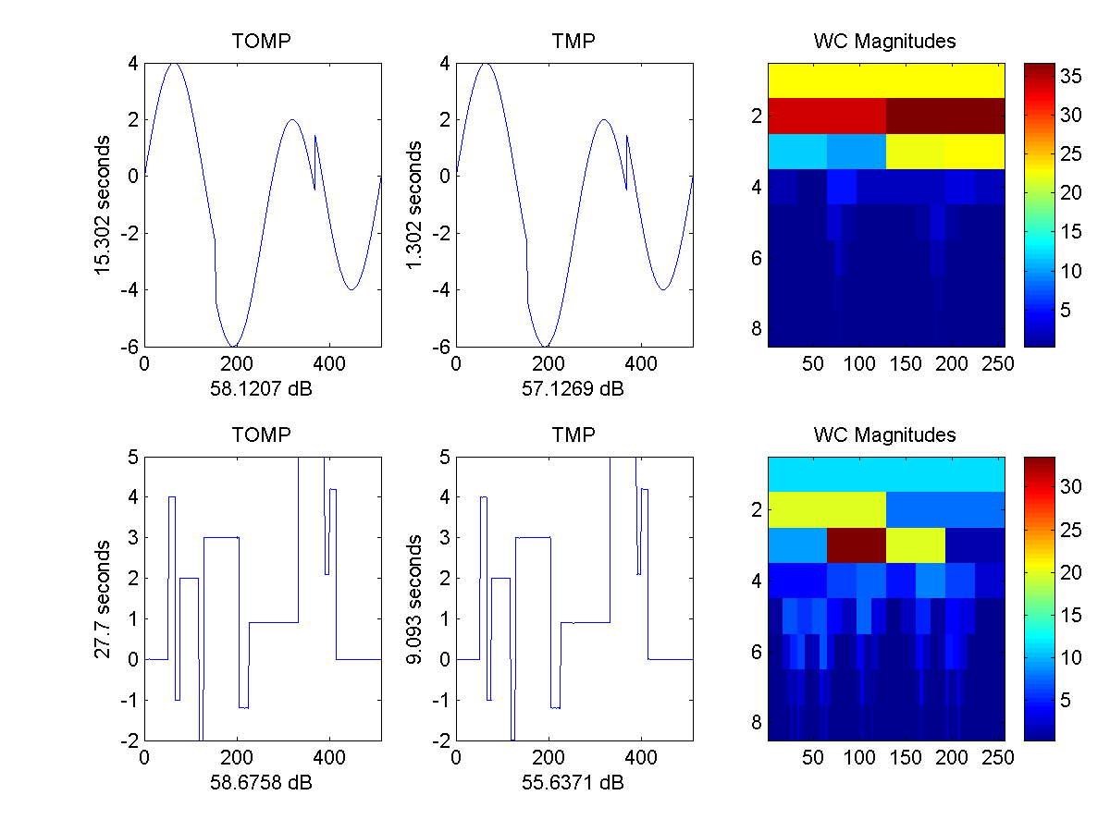
Wavelet Sparse
1-D signals
1-D wavelet transform
scale
amplitude
Typical of wavelet transforms
of natural signals and images (piecewise smooth)
scale
amplitude
time
coefficients

Slide 23
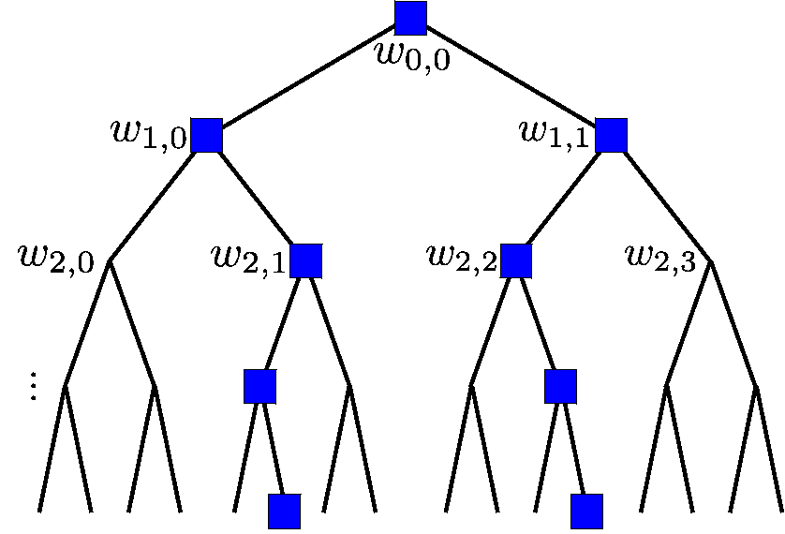
Tree-Sparse
Model: K-sparse coefficients
+ significant coefficients
lie on a rooted subtree
Typical of wavelet transforms
of natural signals and images (piecewise smooth)

Slide 24
Tree-Sparse
Model: K-sparse coefficients
+ significant coefficients
lie on a rooted subtree
Sparse approx: find best set of coefficients
  sorting
  hard thresholding
Tree-sparse approx: find best rooted subtree
of coefficients
  condensing sort and select [Baraniuk]
  dynamic programming [Donoho]

Slide 25
Sparse
Model: K-sparse coefficients
RIP: stable embedding
K-planes

Slide 26
Tree-Sparse
Model: K-sparse coefficients
+ significant coefficients
lie on a rooted subtree
Tree-RIP: stable embedding
K-planes

Slide 27
Tree-Sparse
Model: K-sparse coefficients
+ significant coefficients
lie on a rooted subtree
Tree-RIP: stable embedding
Recovery: new model based algorithms
[VC, Duarte, Hegde, Baraniuk; Baraniuk, VC, Duarte, Hegde]

Slide 28
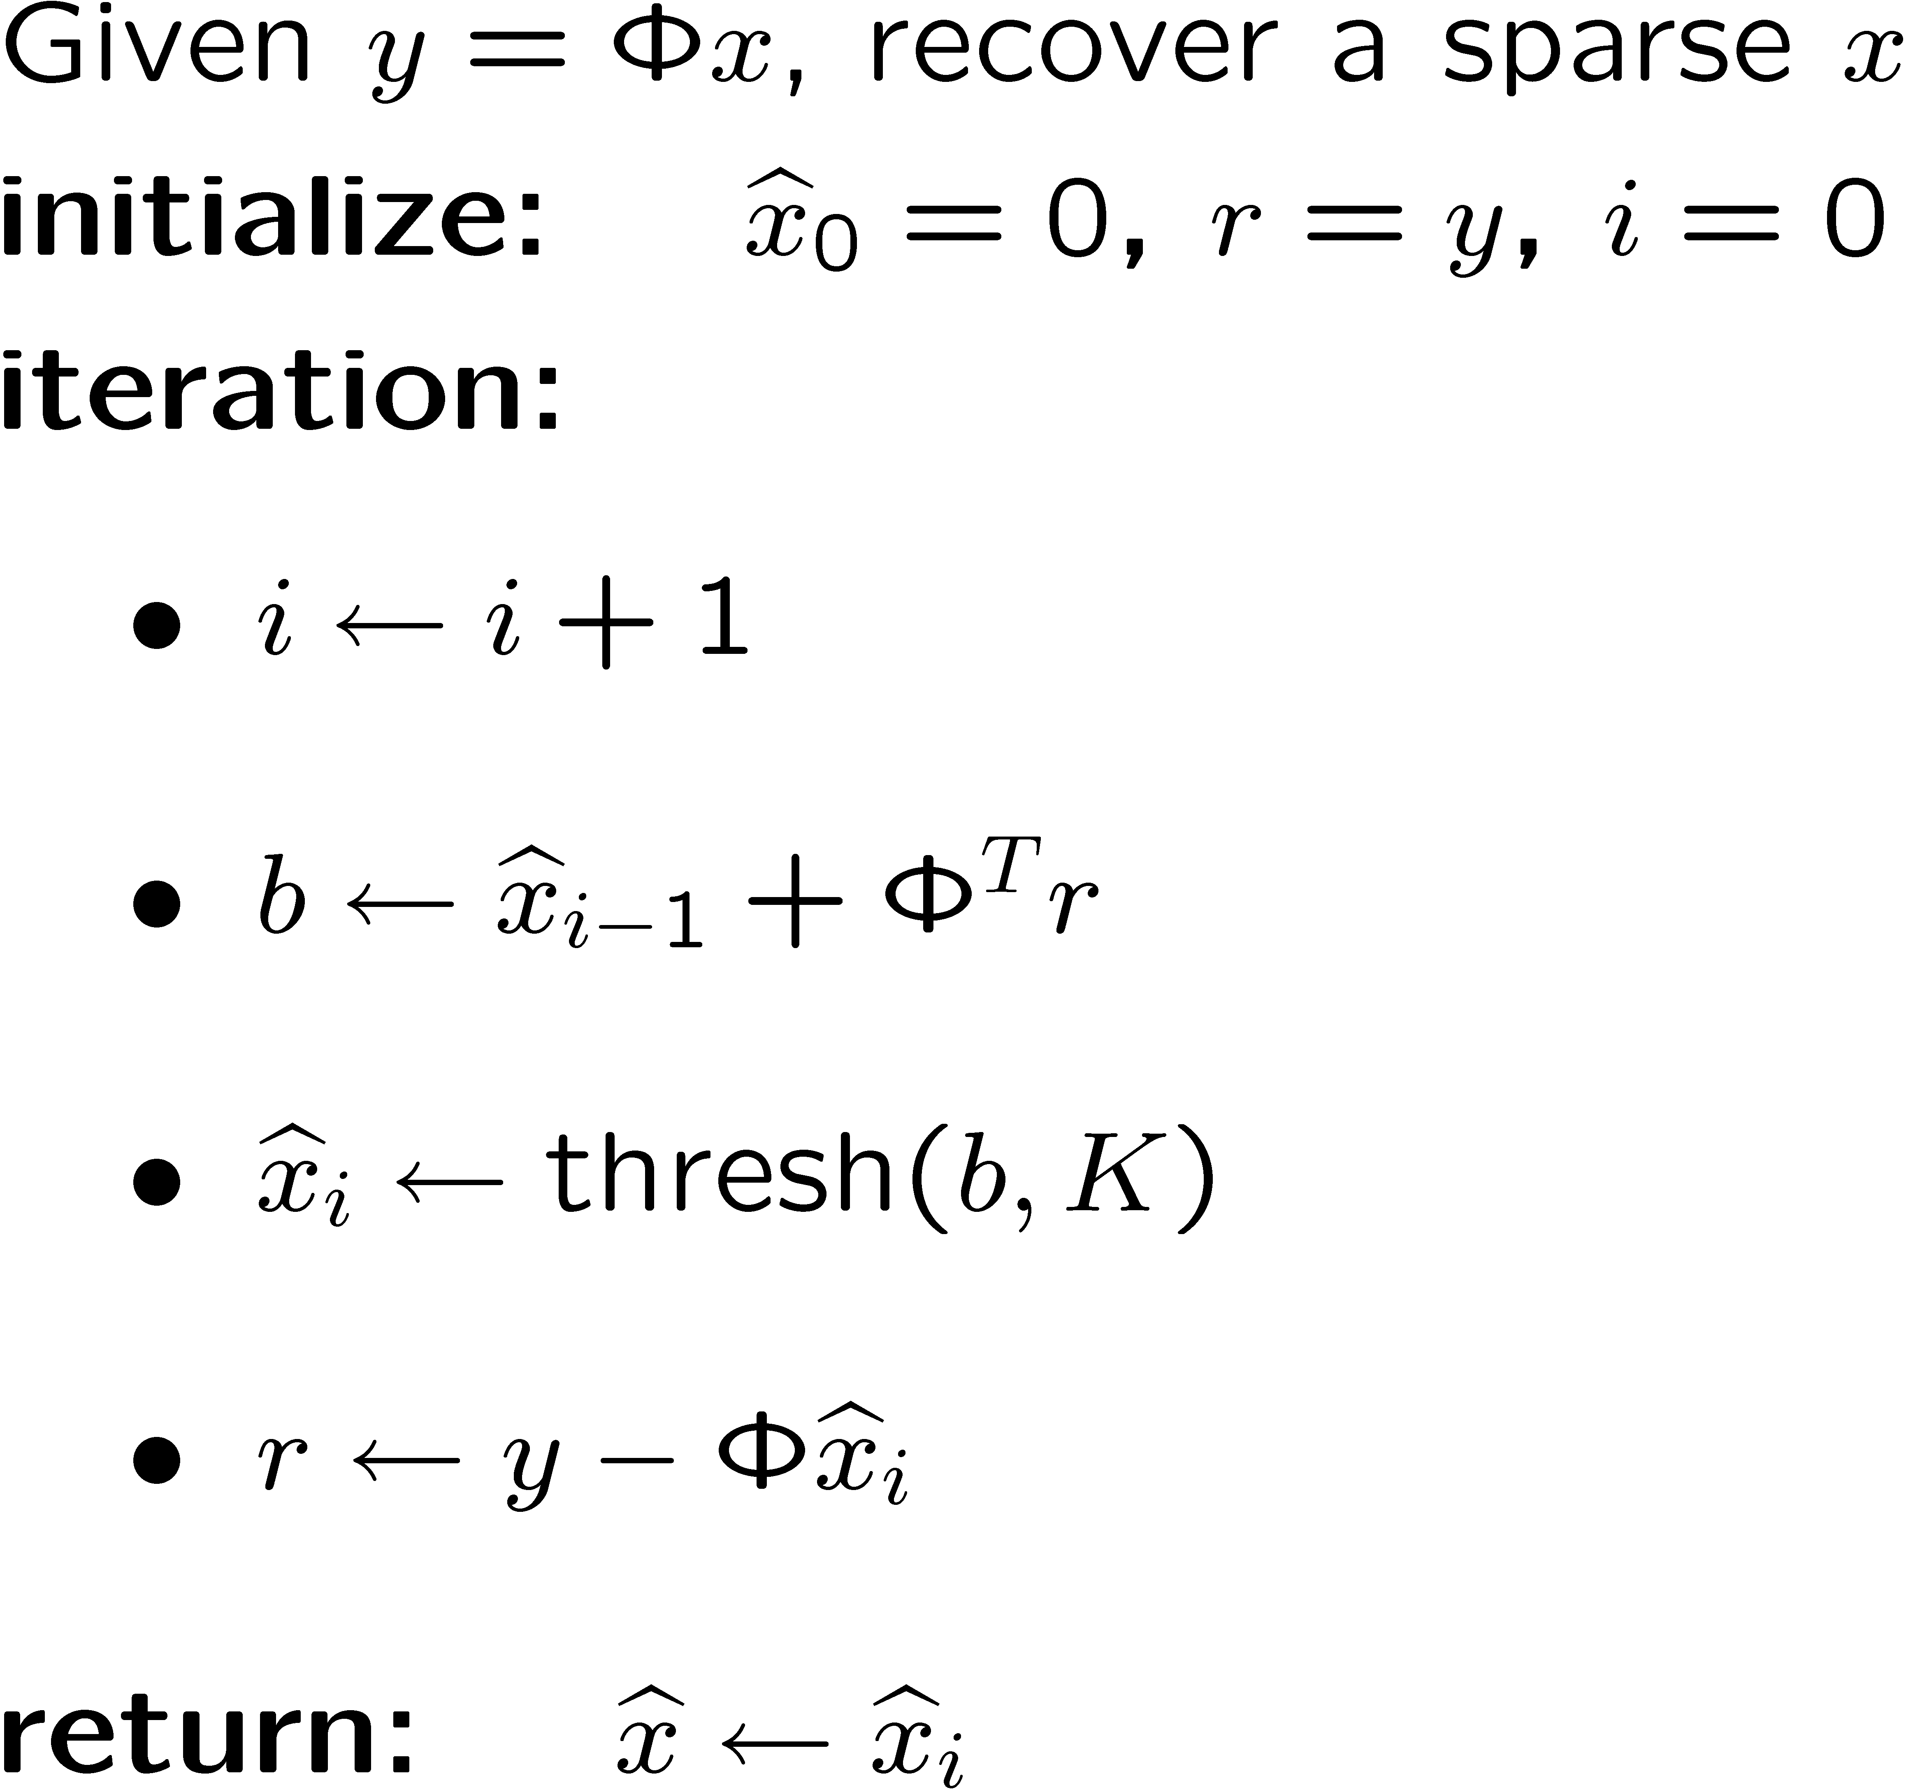
Standard CS Recovery
Iterative Thresholding
  [Nowak, Figueiredo; Kingsbury, Reeves; Daubechies, Defrise, De Mol; Blumensath, Davies; …]
update signal estimate
prune signal estimate
(best K-term approx)
update residual

Slide 29
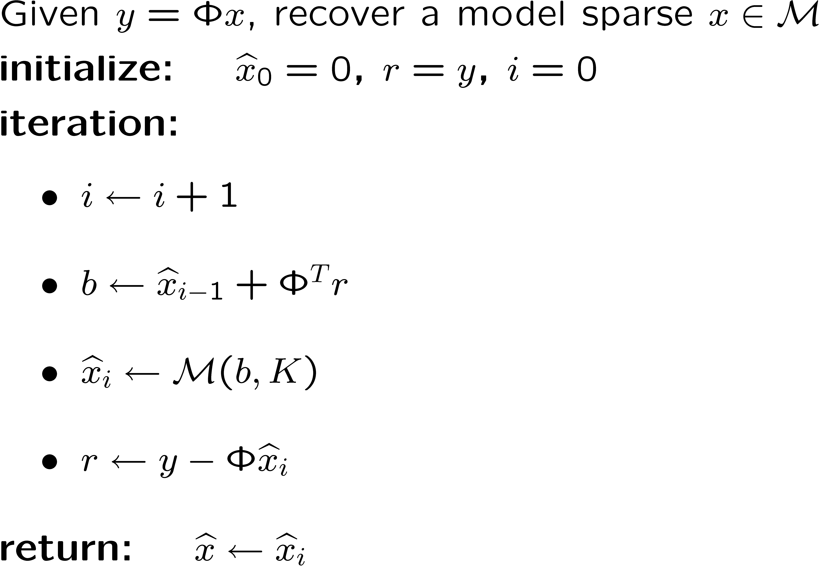
Model-based CS Recovery
Iterative Model Thresholding
  [VC, Duarte, Hegde, Baraniuk; Baraniuk, VC, Duarte, Hegde]
update signal estimate
prune signal estimate
(best K-term model approx)
update residual

Slide 30
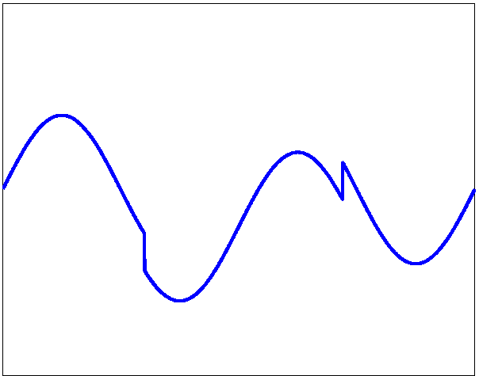
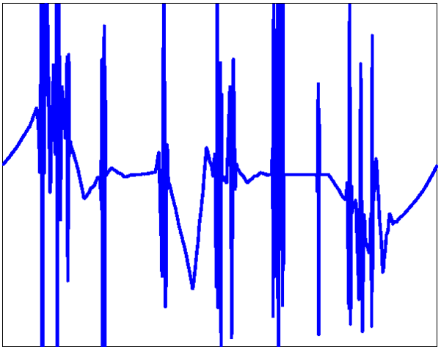
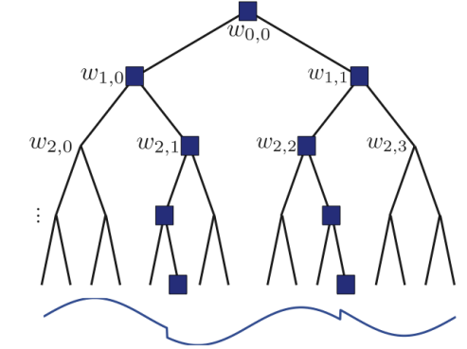
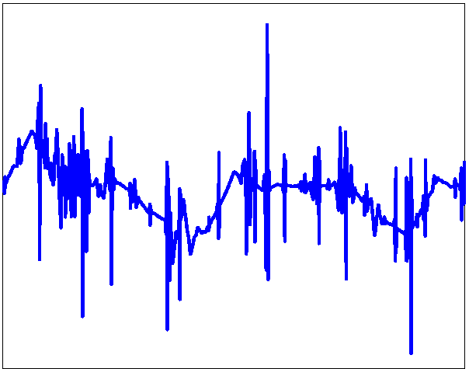
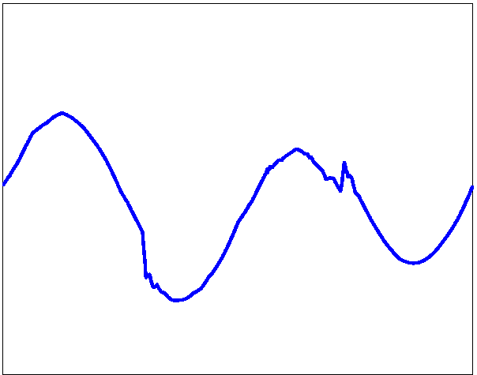
Tree-Sparse Signal Recovery
target signal
CoSaMP, (MSE=1.12)
N=1024
M=80
L1-minimization
(MSE=0.751)
Tree-sparse CoSaMP (MSE=0.037)

Slide 31

Compressible Signals
Real-world signals are compressible, not sparse
Recall: compressible <> well approximated
by sparse
  compressible signals lie close to a union of subspaces
  ie: approximation error decays rapidly as
If has RIP, then
both sparse and
compressible signals
are stably recoverable
sorted index

Slide 32
Model-Compressible Signals
Model-compressible <> well approximated
by model-sparse
  model-compressible signals lie close to a
  reduced union of subspaces
  ie: model-approx error decays rapidly as

Slide 33

Model-Compressible Signals
Model-compressible <> well approximated
by model-sparse
  model-compressible signals lie close to a
  reduced union of subspaces
  ie: model-approx error decays rapidly as
While model-RIP enables stable
model-sparse recovery,
model-RIP is not sufficient for stable
model-compressible recovery at !

Slide 34

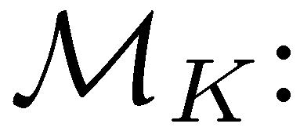
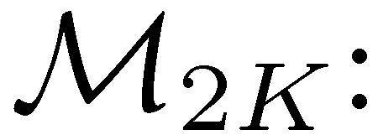

Stable Recovery
Stable model-compressible signal recovery at requires that have both:
  RIP + Restricted Amplification Property
RAmP: controls nonisometry of in the
approximation’s residual subspaces
optimal K-term
model recovery
(error controlled
by RIP)
optimal 2K-term
model recovery
(error controlled
by RIP)
residual subspace
(error not controlled
by RIP)

Slide 35


Tree-RIP, Tree-RAmP
Theorem: An MxN iid subgaussian random matrix has the Tree(K)-RIP if
Theorem: An MxN iid subgaussian random matrix
has the Tree(K)-RAmP if

Slide 36


Simulation
Number samples for correct recovery
Piecewise cubic
signals +
wavelets
Models/algorithms:
  compressible (CoSaMP)
  tree-compressible
  (tree-CoSaMP)

Slide 37

Performance of Recovery
Using model-based IT, CoSaMP with RIP and RAmP
Model-sparse signals
  noise-free measurements: exact recovery
  noisy measurements: stable recovery
Model-compressible signals
  recovery as good as K-model-sparse approximation
CS recovery
error
signal K-term
model approx error
noise
[Baraniuk, VC, Duarte, Hegde]

Slide 38
Other Useful Models
When the model-based framework makes sense:
  model with
    fast approximation algorithm
  sensing matrix with
    model-RIP
    model-RAmP
Ex: block sparsity / signal ensembles
[Tropp, Gilbert, Strauss], [Stojnic, Parvaresh, Hassibi],
[Eldar, Mishali], [Baron, Duarte et al], [Baraniuk, VC, Duarte, Hegde]
Ex: clustered signals
[VC, Duarte, Hegde, Baraniuk], [VC, Indyk, Hegde, Baraniuk]
Ex: neuronal spike trains [Hegde, Duarte, VC – best student paper award]

Slide 39


Clustered Sparsity
Model clustering of significant
pixels in space domain using
graphical model (MRF)
Ising model approximation
via graph cuts
[VC, Duarte, Hedge, Baraniuk]
target
Ising-model
recovery
CoSaMP
recovery
LP (FPC)
recovery

Slide 40
Conclusions
Why CS works: stable embedding for signals
with concise geometric structure
Sparse signals <> model-sparse signals
Compressible signals <> model-compressible signals
  upshot: fewer measurements
  more stable recovery
  new concept: RAmP

Slide 41


